Slide 1










#semanticClimate
LIBERATING KNOWLEDGE FROM
CLIMATE-RELATED REPORTS
- UN DATATHON 2023
Supporters:
This work is licensed under Attribution 4.0 International
Joint Lab:
Team:
Shweata N. Hegde
Gayatri
Ayush Garg
Jemi Jacob
Grace Jimenez
Mentors:
Peter Murray-Rust
Simon Worthington
Xavier Tibau Alberdi

Slide 2
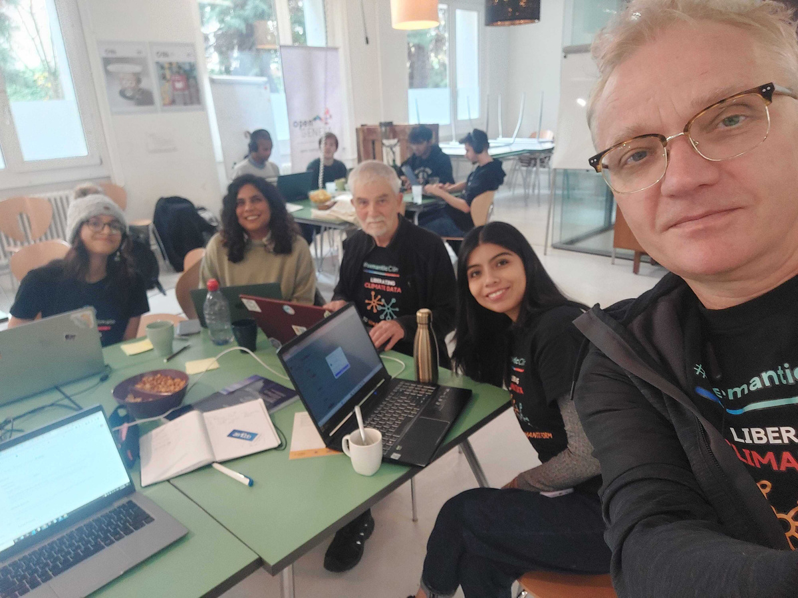
ABOUT #SEMANTICCLIMATE
We make software to make climate knowledge accessible to all -- both machine and humans
Create reusable Citizen Science outreach content packages and event formats:
Hackathons
Intern programmes
Code and data science learning packages
Climate Reader collation tools for city climate plans, climate vulnerability assessment, and other settings
Train-the-trainer formats (AKA Carpentries)
Team and mentors at SDG space Geneva

Slide 3



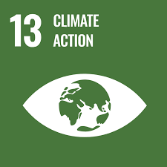
UN DATATHON 2023 THEME & SDGS
Food systems
Energy access and affordability
Digital connectivity
Education
Jobs and social protection
Climate change, biodiversity loss and pollution

Slide 4



PROBLEM STATEMENT, METHODOLOGY, & DATA
Problem statement: Support a user of UN Data who is exploring a questions on ‘Climate Vulnerability Indexes’ with Big Data analysis of the global scientific literature, with geolocation.
Methodologies: Iterative software development using hackathons and rapid prototyping, creating replicable frameworks, open notebook science
UN Data used: Carbon Disclosure Project (CDP), 2022 Cities Climate Hazards - https://data.cdp.net/Climate-Hazards/2022-Cities-Climate-Hazards/rdq4-d52n

Slide 5
#SEMANTICCLIMATE PRODUCTS / USE CASES
CLIMATE VULNERABILITY ASSESSMENT TRACKER FOR IPCC REPORTS
SEMANTIC GLOSSARY FOR UN IPCC READERS
PDF READER FOR UN DIPLOMATS

Slide 6

USE CASE #1: CLIMATE VULNERABILITY ASSESSMENT TRACKER FOR IPCC REPORTS
Help UN Data users analyze data, access open scientific literature, and create replicable workflows using dashboards and Open Science principles
#CODE PYGETPAPERS TOOL

Slide 7





Scenario 1 - WITHOUT PYGETPAPERS TOOL: Climate Scientist wants to create a Climate Change Vulnerability Index for specific region within their country
1000s of related and unrelated data and a methodology from ChatGPT with no scientific proof
Uses Google search, ChatGPT and Scientific Lit browsers
Creates a Climate Change Vulnerability Index
Manually analyses both the data sets
UN Data on Climate Vulnerabilities
The whole process is time-intensive, resource-intensive, is non-replicable and might not be contextual

Slide 8


Scenario 2 - WITH PYGETPAPERS TOOL: Climate Scientist wants to create a Climate Change Vulnerability Index for specific region within their country
Climate vulnerability related articles
Analysis on region, author, specific vulnerabilities
Uses pygetpapers-docanalysis
Creates Vulnerability Assessment Framework
Contextual, replicable and easy
UN Data on Climate Vulnerabilities
Papers can be:
Geo located
Retrieved and downloaded automatically
An interactive dashboard can be produced

Slide 9
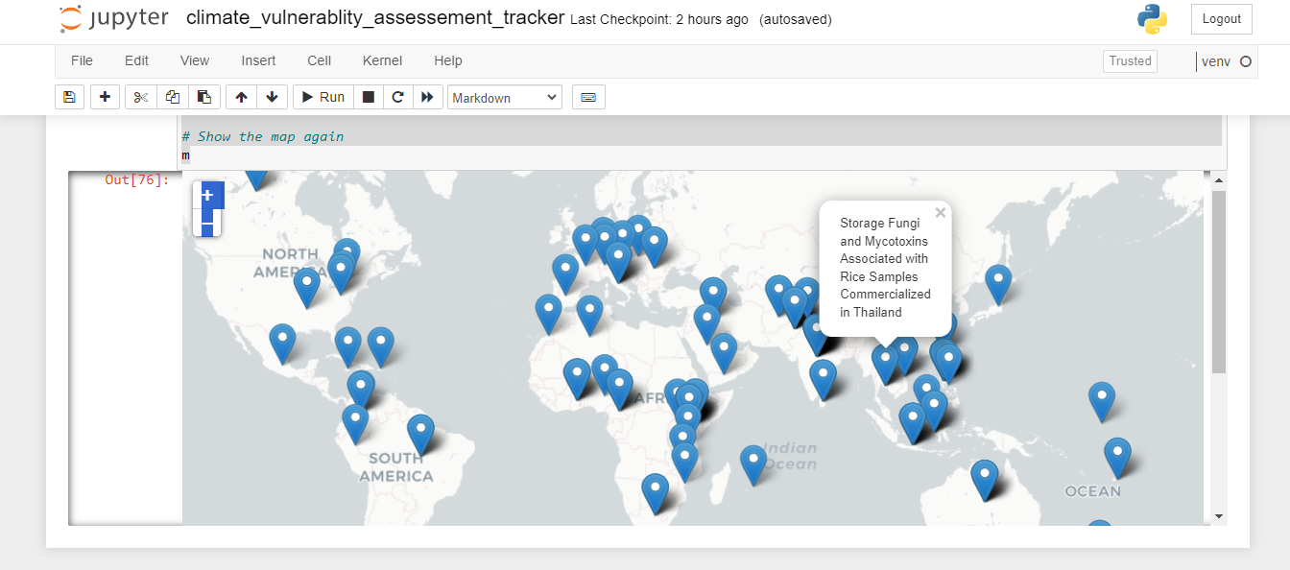
DEMO
Code link

Slide 10
USE CASE #2: SEMANTIC GLOSSARY FOR UN IPCC READERS
#CODE IPCC GLOSSARY

Slide 11
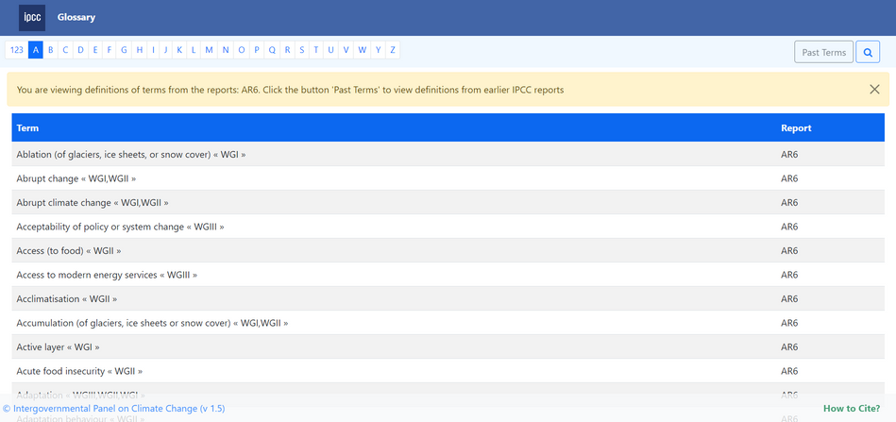
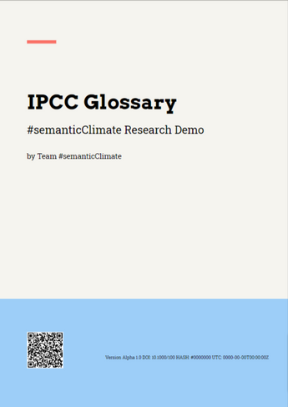
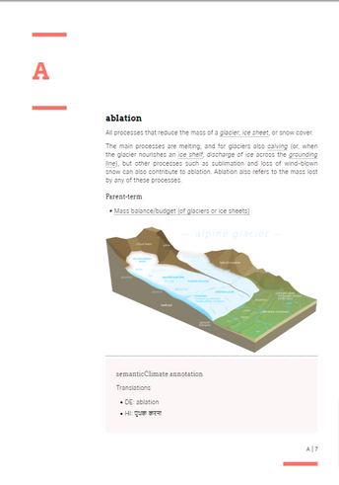
CONVERTING THE IPCC GLOSSARY
Input
Problem statement: To make the glossary useful for finding sections in the reports and in the data. In addition adding a layer of crowdsourced multiligual entries
What we do
Screen scraping and crowdsourcing
CSS Typesetting
Multilingual
Convert from to:
Output

Slide 12
A PROTOTYPE GLOSSARY
Problem statement: To make the glossary useful for finding sections in the reports and in the data. In addition adding a layer of crowdsourced multiligual entries
What we do
Screen scraping and crowdsourcing
CSS Typesetting
Multilingual
Linking and enrichment (annotation)
Crowdsourcing: from Wikipedia and and Wikidata
Link related resources - IPCC Reports, Data, Working Groups, etc: Annotate Wikibase

Slide 13




THE DREAM WORKFLOW!
Data model
Source
TDM [py4ami]
Terminology Services
GitHub/Lab (output storage)
Outputs (HTML/XML)
CSS Typesetting [Vivliostyle]: Paged web, scrolling web, mobile, PDF, PoD, eBook, etc.

Slide 14
USE CASE #3: PDF READER FOR UN DIPLOMATS
#CODE PDF READER

Slide 15
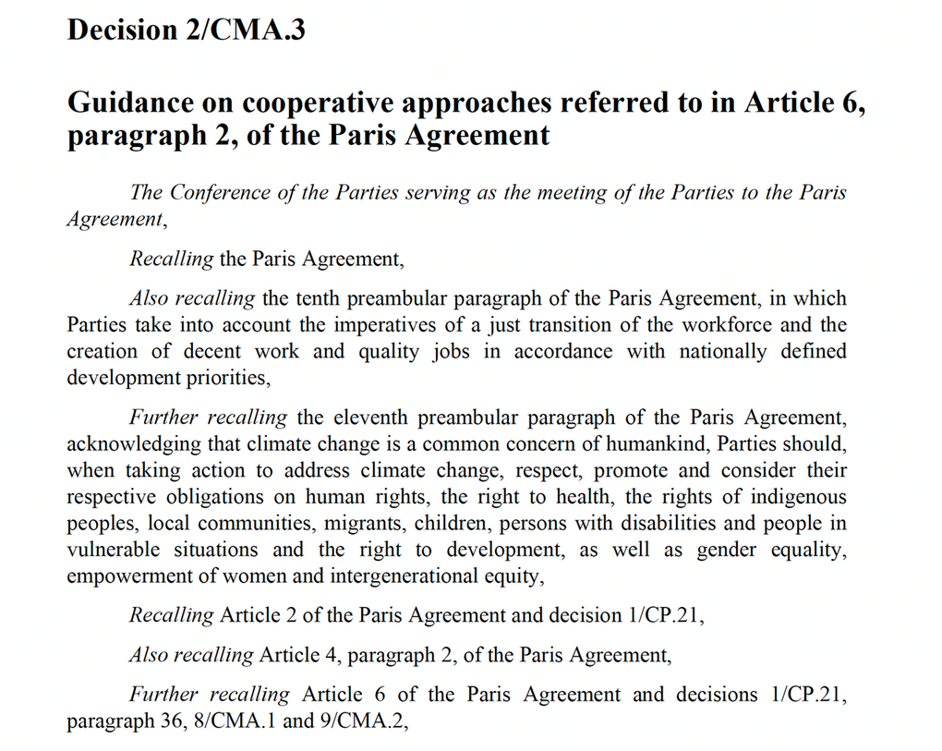
MACHINE-READABLE DOCUMENTS?
~2000 UNFCCC documents over 30 years, 50 statements/doc => over 1 statements
Cross-references between documents

Slide 16



SOURCE, RELATION, TARGET DOCUMENTS!
SOURCE
TARGET
DOCUMENTS
RELATION

Slide 17
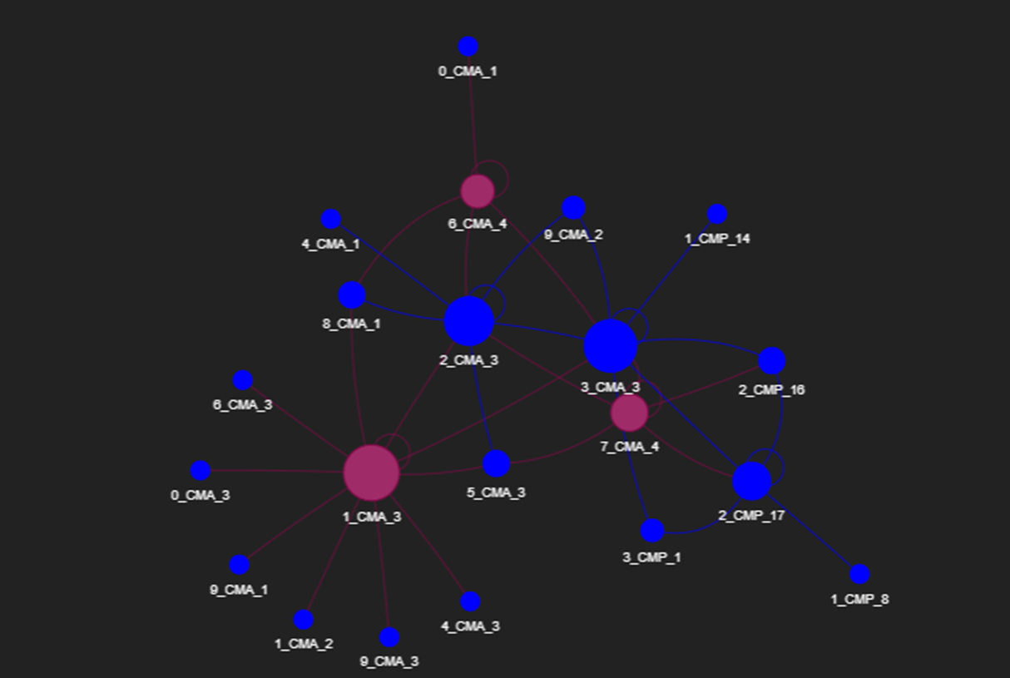
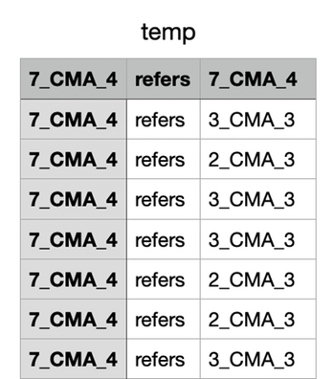
CONVERT PDF TO HTML AUTOMATICALLY
Problem statement: To automatically validate authoring and make statments in documents discoverable
search for SOURCE, RELATION, TARGETS
Automatic, 1 sec/document
Gives network graph
SOURCE
TARGET

Slide 18
JOIN US
THANK YOU!
Website:
www.semanticClimate.org
E-mail:
semanticClimate@gmail.com
Twitter:
@semanticClimate

